Slide 1
In this paper we propose 10,000,000 algorithms:
The (semi-)automatic design of (heuristic) algorithms
Introducing John Woodward
Edmund Burke, Gabriela Ochoa, Jerry Swan, Matt Hyde, Graham Kendall, Ender Ozcan, Jingpeng Li, Libin Hong
John.Woodward@cs.stir.ac.uk
Notes:
Miller and langdon, SPECIAL ANOUNCEMENT
SELF CONTAINED
IMPROVE THIS TALK EACH TIME I GIVE IT
TAKE THE OTHER TALKS WITH ME TOO.

Slide 2
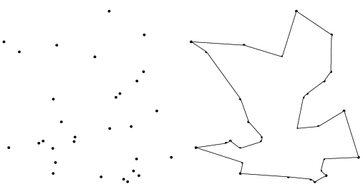
Conceptual Overview
Combinatorial problem e.g. TSP salesman
Exhaustive search?
Genetic Algorithm
heuristic – permutations
Travelling Salesman
Tour
Single tour NOT EXECUTABLE!!!
Genetic Programming
code fragments in for-loops.
Give a man a fish and he
will eat for a day.
Teach a man to fish and he
will eat for a lifetime.
Travelling Salesman Instances
TSP algorithm
EXECUTABLE on MANY INSTANCES!!!
Notes:
If you are in the wrong room

Slide 3
Plan: From Evolution to Automatic Design
  Generate and test method 2
  Natural (Artificial) Evolution 2
  Genetic Algorithms and Genetic Programming 2
  Motivations (conceptual and theoretical) 3
  One (or 2) example of automatic generation
  Genetic Algorithms 17
  (meta-learning, mutation operators, representation, problem classes, experiments).
  7. Bin packing 6
  8. Wrap up. Closing comments to the jury 5
  9. Questions (during AND after…) Please :)
  Now is a good time to say you are in the wrong room

Slide 4
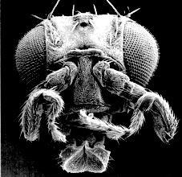
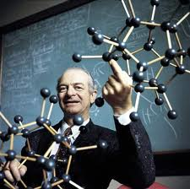
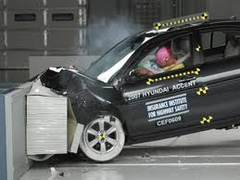
Generate and Test (Search) Examples
Feedback loop
Humans
Computers
Manufacturing e.g. cars
Evolution “survival of the fittest”
“The best way to have a good idea is to have lots of ideas” (Pauling).
Computer code (bugs+specs), Medicines
Scientific Hypotheses, Proofs, …
Generate
Test
Notes:
http://neurophilosophy.wordpress.com/2006/08/09/the-role-of-hox-genes-in-development/
What is wrong with the test and generate method for programs.
GENERALIZE “The best way to have a good idea is to have lots of ideas” (Pauling).

Slide 5

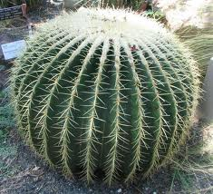
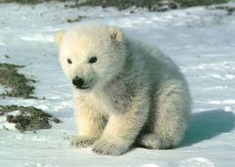
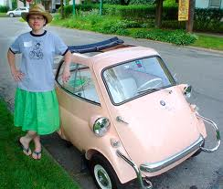
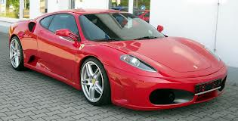
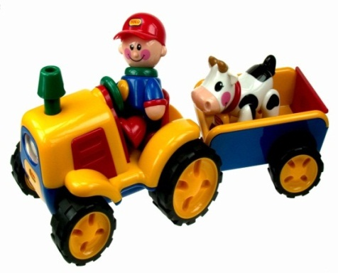
Fit For Purpose
Evolution generates organisms on a particular environment (desert/arctic).
Ferrari vs. tractor (race track or farm)
Similarly we should design meta-heuristics for particular problem class.
“in this paper we propose a new mutation operator…” “what is it for…”
Adaptation?
Colour?
Notes:
A cactus is a specialised leaf. What colour is a polar bear.
TEA CUP AND TEA SPOON.

Slide 6
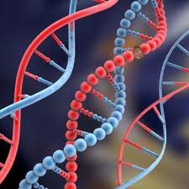
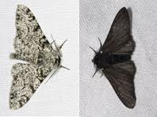
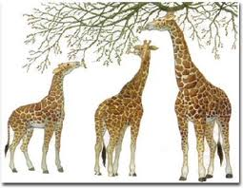
(Natural / Artificial) Evolutionary Process
  1. variation (difference)
  2. selection (evaluation)
  3. inheritance (a)sexual reproduction)
Inheritance
Off-spring
have similar
Genotype
(phenotype)
PERFECT
CODE
Mutation/Variation
New genes introduced
into gene pool
Selection
Survival of the fittest
Peppered moth evolution
Notes:
Sexual reproduction is not necessary for evolution.
Why do giraffes have long necks.

Slide 7
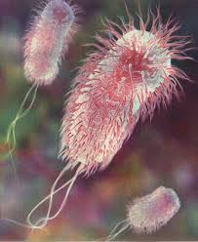

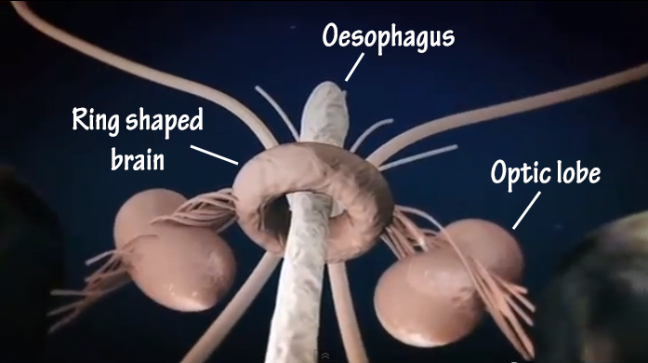
(Un) Successful Evolutionary Stories
40 minutes to copy DNA but only 20 minutes to reproduce.
Ants know way to nest.
3D noise location
Bull dogs…
Giant Squid brains
Wheels?
Notes:
3D – two ears define a circle.
Wheels 1. bacteria, 2. hedgehog, 3. tumble weed.
What is wrong with a big head. (fontella)
Sheep 2X wool, cows 5X milk

Slide 8
Meta-heuristics / Computational Search
x1
Space of
permutation
solutions
e.g. test case
Prioritisation
(ORDERING).
x1
Space of bit
string solutions
e.g. test case
Minimization
SUBSET SELECTION
Space of programs
e.g. robot control,
Regression,
classification
123
132
213
231
312
321
x1
00
01
10
11
incR1
decR2
clrR3
A set of candidate solutions
Permutations O(n!), Bit strings O(2^n), Program O(?)
For small n, we can exhaustively search.
For large n, we have to sample with Metaheuristic /Search algorithm. Combinatorial explosion.
Trade off sample size vs. time.
GA and GP are biologically motivated meta-heuristics.

Slide 9
Genetic Algorithms (Bit-strings)
Breed a population
of BIT STRINGS.
1. Assign a
Fitness value
to each bit string, Fit(01010010000) = 99.99
Combinatorial Problem / encoding
Representation
TRUE/FASLE
in Boolean satifiability (CNF),
Knapsack (weight/cost),
Subset sum=0…
01110010110
01110010110
01011110110
01011111110
01010010000
…
3. Mutate each individual
01110010110
One point mutation
01110011110
2. Select the better/best with higher probability from the population to be promoted to the next generation …
Notes:
Any problem on a computer can be represented as a bit string.
e.g. knapsack problem, combinatorial problems.

Slide 10
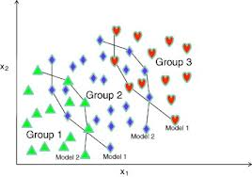
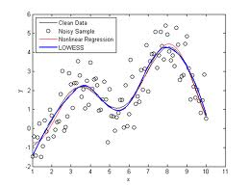
(Linear) Genetic Programming (Programs)
weight
Breed a population
of PROGRAMS.
1. Assign a
Fitness value
to each program,
Fit(Rpt R1, Clr R4,…) = 99.99
Inc R1, R2=R4*R4…
Rpt R1, Clr R4,Cpy R2 R4
R4=Rnd, R5=Rnd,…
If R1<R2 inc R3,
…
height
Programs for
Classification,
and Regression.
3. Mutate each individual
Rpt R1 R2, Clr R4, Cpy R2 R4
One point mutation
Rpt R1 R2, Clr R4, STP
2. Select the better/best with higher probability from the population to be promoted to the next generation. Discard the worst.
output
input
Notes:
Any problem on a computer can be represented as a bit string.
e.g. knapsack problem, combinatorial problems.

Slide 11
Theoretical Motivation 1
Search
Algorithm a
Search
space
Objective
Function f
P (a, f)
x1
x1
x1
1.
2.
3.
X1.
X2.
X3.
Y1.
Y2.
Y3.
SOLUTION
PROBLEM
A search space contains the set of all possible solutions.
An objective function determines the quality of solution.
A search algorithm determines the sampling order (i.e. enumerates i.e. without replacement). It is a (approximate) permutation.
Performance measure P (a, f) depend only on y1, y2, y3
Aim find a solution with a near-optimal objective value using a search algorithm. ANY QUESTIONS BEFORE NEXT SLIDE?
Notes:
Temptation is to just write a search algorithm.

Slide 12

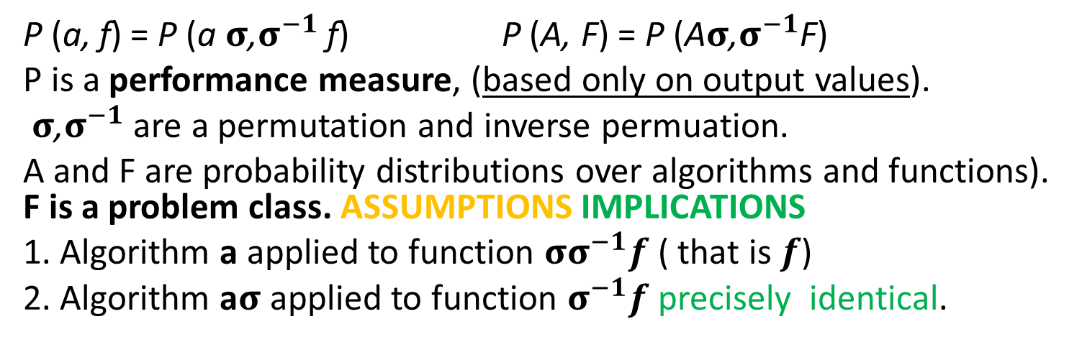
Theoretical Motivation 2
Search
Algorithm a
Search
space
Objective
Function f
σ
$${\text{σ}}^{−1}$$
x1
x1
x1
x1
x1
1.
2.
3.
1.
2.
3.
1.
2.
3.
1.
2.
3.
1.
2.
3.
P (a, f) = P (a$σ$,$σ^{−1}$ f) P (A, F) = P (A$σ$,$σ^{−1}$F)
P is a performance measure, (based only on output values).
$σ$,$σ^{−1}$ are a permutation and inverse permuation.
A and F are probability distributions over algorithms and functions). F is a problem class. ASSUMPTIONS IMPLICATIONS
1. Algorithm a applied to function ${σσ}^{−1}f$ ( that is $f$)
2. Algorithm a$σ$ applied to function $σ^{−1}f$ precisely identical.
Notes:
Not finite, not computable, not all function, not closed under permutation, focussed sets.
Implications. Do not propose a metaheuristic in isolation .
Assumptions - no revisiting, count number of evaluations (ignore execution time. )

Slide 13



One Man – One Algorithm
Researchers design heuristics by hand and test them on problem instances or arbitrary benchmarks off internet.
Presenting results at conferences and publishing in journals. In this talk/paper we propose a new algorithm…
What is the target problem class they have in mind?
Human 1
Heuristic
Algorithm1
Human2
Heuristic
Algorithm2
Human3
Heuristic
Algorithm3
Notes:
Ga
Ga’
Ga ‘ version 2.o
Ga ‘ version 2.o hydidized with knobs and whistles.

Slide 14

One Man ….Many Algorithms
Space of Algorithms
Algorithmic
framework
1. Challenge is defining an algorithmic framework (set) that includes useful algorithms, and excludes others.
2. Let Genetic Programming select the best algorithm for the problem class at hand. Context!!! Let the data speak for itself without imposing our assumptions.
GA mutations
. Facebook
. bubble sort
. MS word
Mutation 1
X
Mutation 2
X
X
Mutation
10,000
. Random Number
. Linux operating system
Search
Space

Slide 15
Meta and Base Learning
At the base level we are learning about a specific function.
At the meta level we are learning about the problem class.
We are just doing “generate and test” on “generate and test”
What is being passed with each blue arrow?
Training/Testing and Validation
Meta level
Function class
Mutation operator designer
Function to optimize
GA
base level
Conventional GA

Slide 16
Compare Signatures (Input-Output)
Genetic Algorithm
(B^n -> R) -> B^n
Input is an objective function mapping bit-strings of length n to a real-value.
Output is a (near optimal) bit-string
i.e. the solution to the problem instance
Genetic Algorithm Designer
[(B^n -> R)] ->
((B^n -> R) -> B^n)
Input is a list of functions mapping bit-strings of length n to a real-value (i.e. sample problem instances from the problem class).
Output is a (near optimal) mutation operator for a GA
i.e. the solution method (algorithm) to the problem class
We are raising the level of generality at which we operate.
Give a man a fish and he will eat for a day, teach a man to fish and…
Notes:
Fish the north sea dry…

Slide 17
Two Examples of Mutation Operators
One point mutation flips ONE single bit in the genome (bit-string).
(1 point to n point mutation)
Uniform mutation flips ALL bits with a small probability p. No matter how we vary p, it will never be one point mutation.
Lets invent some more!!!
NO, lets build a general method
BEFORE
0 | 1 | 1 | 0 | 0 | 0
AFTER
0 | 1 | 1 | 0 | 1 | 0
BEFORE
0 | 1 | 1 | 0 | 0 | 0
AFTER
0 | 0 | 1 | 0 | 0 | 1

Slide 18
Off-the-Shelf Genetic Programming to Tailor Make Genetic Algorithms for Problem Class
novel
mutation
heuristics
search
space
Meta-level
Genetic Programming
Iterative Hill Climbing
(mutation operators)
x
x
x
x
Fitness
value
Mutation
operator
One
Point
mutation
Uniform
mutation
Genetic Algorithm
Base-level
Commonly used
Mutation operators

Slide 19
Building a Space of Mutation Operators
Inc | 0
Dec | 1
Add | 1,2,3
If | 4,5,6
Inc | -1
Dec | -2
Program counter pc | 2
WORKING REGISTERS
110 | -1 | +1 | 43 | …
INPUT-OUTPUT REGISTERS
-20 | -1 | +1 | 20 | …
A program is a list of instructions and arguments.
A register is set of addressable memory (R0,..,R4).
Negative register addresses means indirection.
A program can only affect IO registers indirectly.
+1 (TRUE) -1 (FALSE) +/- sign on output register.
Insert bit-string on IO register, and extract from IO register

Slide 20
Arithmetic Instructions
These instructions perform arithmetic operations on the registers.
Add Ri ← Rj + Rk
Inc Ri ← Ri + 1
Dec Ri ← Ri − 1
Ivt Ri ← −1 ∗ Ri
Clr Ri ← 0
Rnd Ri ← Random([−1, +1]) //mutation rate
Set Ri ← value
Nop //no operation or identity

Slide 21
Control-Flow Instructions
These instructions control flow (NOT ARITHMETIC). They include branching and iterative imperatives.
Note that this set is not Turing Complete!
If if(Ri > Rj) pc = pc + |Rk| why modulus
IfRand if(Ri < 100 * random[0,+1]) pc = pc + Rj//allows us to build mutation probabilities WHY?
Rpt Repeat |Ri| times next |Rj| instruction
Stp terminate

Slide 22
Expressing Mutation Operators
Line UNIFORM ONE POINT MUTATION
0 Rpt, 33, 18 Rpt, 33, 18
1 Nop Nop
2 Nop Nop
3 Nop Nop
4 Inc, 3 Inc, 3
5 Nop Nop
6 Nop Nop
7 Nop Nop
8 IfRand, 3, 6 IfRand, 3, 6
9 Nop Nop
10 Nop Nop
11 Nop Nop
12 Ivt,−3 Ivt,−3
13 Nop Stp
14 Nop Nop
15 Nop Nop
16 Nop Nop
Uniform mutation
Flips all bits with a
fixed probability.
4 instructions
One point mutation
flips a single bit.
6 instructions
Why insert NOP?
We let GP start with these programs and mutate them.

Slide 23
Parameter settings for (meta level) Genetic Programming Register Machine
Parameter Value
restart hill-climbing 100
hill-climbing iterations 5
mutation rate 3
program length 17
Input-output register size 33 or 65
working register size 5
seeded uniform-mutation
fitness best in run,
averaged over 20 runs
Note that these parameters are not optimized.

Slide 24
Parameter settings for the (base level) Genetic Algorithm
Parameter Value
Population size 100
Iterations 1000
bit-string length 32 or 64
generational model steady-state
selection method fitness proportional
fitness function see next slide
mutation register machine
(NOT one point/uniform )
These parameters are not optimized – except for the mutation operator (algorithmic PARAMETER).

Slide 25
7 Problem Instances
7 real–valued functions, we will convert to discrete binary optimisations problems for a GA.
number function
1 x
2 sin2(x/4 − 16)
3 (x − 4) ∗ (x − 12)
4 (x ∗ x − 10 ∗ cos(x))
5 sin(pi∗x/64−4) ∗ cos(pi∗x/64−12)
6 sin(pi∗cos(pi∗x/64 − 12)/4)
7 1/(1 + x /64)

Slide 26
Function Optimization Problem Classes
To test the method we use binary function classes
We generate a Normally-distributed value t = −0.7 + 0.5 N (0, 1) in the range [-1, +1].
3. We linearly interpolate the value t from the range [-1, +1] into an integer in the range [0, 2^num−bits −1], and convert this into a bit-string t′.
4. To calculate the fitness of an arbitrary bit-string x, the hamming distance between x and the target bit-string t′ is calculated (giving a value in the range [0,numbits]). This value is then fed into one of the 7 functions.

Slide 27
Results – 32 bit problems
Problem classes Means and standard deviations | Uniform Mutation | One-point mutation | RM-mutation
p1 mean | 30.82 | 30.96 | 31.11
p1 std-dev | 0.17 | 0.14 | 0.16
p2 mean | 951 | 959.7 | 984.9
p2 std-dev | 9.3 | 10.7 | 10.8
p3 mean | 506.7 | 512.2 | 528.9
p3 std-dev | 7.5 | 6.2 | 6.4
p4 mean | 945.8 | 954.9 | 978
p4 std-dev | 8.1 | 8.1 | 7.2
p5 mean | 0.262 | 0.26 | 0.298
p5 std-dev | 0.009 | 0.013 | 0.012
p6 mean | 0.432 | 0.434 | 0.462
p6 std-dev | 0.006 | 0.006 | 0.004
p7 mean | 0.889 | 0.89 | 0.901
p7 std-dev | 0.002 | 0.003 | 0.002

Slide 28
Results – 64 bit problems
Problem classes Means and stand dev | Uniform Mutation | One-point mutation | RM-mutation
p1 mean | 55.31 | 56.08 | 56.47
p1 std-dev | 0.33 | 0.29 | 0.33
p2 mean | 3064 | 3141 | 3168
p2 std-dev | 33 | 35 | 33
p3 mean | 2229 | 2294 | 2314
p3 std-dev | 31 | 28 | 27
p4 mean | 3065 | 3130 | 3193
p4 std-dev | 36 | 24 | 28
p5 mean | 0.839 | 0.846 | 0.861
p5 std-dev | 0.012 | 0.01 | 0.012
p6 mean | 0.643 | 0.643 | 0.663
p6 std-dev | 0.004 | 0.004 | 0.003
p7 mean | 0.752 | 0.7529 | 0.7684
p7 std-dev | 0.0028 | 0.004 | 0.0031

Slide 29
p-values T Test for 32 and 64-bit functions on the7 problem classes
 | 32 bit | 32 bit | 64 bit | 64 bit
class | Uniform | One-point | Uniform | One-point
p1 | 1.98E-08 | 0.0005683 | 1.64E-19 | 1.02E-05
p2 | 1.21E-18 | 1.08E-12 | 1.63E-17 | 0.00353
p3 | 1.57E-17 | 1.65E-14 | 3.49E-16 | 0.00722
p4 | 4.74E-23 | 1.22E-16 | 2.35E-21 | 9.01E-13
p5 | 9.62E-17 | 1.67E-15 | 4.80E-09 | 4.23E-06
p6 | 2.54E-27 | 4.14E-24 | 3.31E-24 | 3.64E-28
p7 | 1.34E-24 | 3.00E-18 | 1.45E-28 | 5.14E-23

Slide 30
Rebuttal to Reviews comments
1. Did we test the new mutation operators against standard operators (one-point and uniform mutation) on different problem classes?
NO – the mutation operator is designed (evolved) specifically for that class of problem.
Do you want to try on my tailor made trousers ?
I think I should now, to demonstrate this.
2. Are we taking the training stage into account?
NO, we are just comparing mutation operators in the testing phase – Anyway how could we meaningfully compare “brain power” (manual design) against “processor power” (evolution).
I think….

Slide 31
Impact of Genetic Algorithms
Genetic Algorithms are one of the most referenced academic works.
http://citeseerx.ist.psu.edu/stats/authors?all=true D. Goldberg 16589
Genetic Algorithms in Search, Optimization, and Machine Learning D Goldberg Reading, MA, Addison-Wesley 47236 1989
http://www2.in.tu-clausthal.de/~dix/may2006_allcited.php
64. D. Goldberg: 7610.21
http://www.cs.ucla.edu/~palsberg/h-number.html
84 David E. Goldberg (UIUC)

Slide 32
Additions to Genetic Programming
1. final program is part human constrained part (for-loop) machine generated (body of for-loop).
2. In GP the initial population is typically randomly created. Here we (can) initialize the population with already known good solutions (which also confirms that we can express the solutions). (improving rather than evolving from scratch) – standing on shoulders of giants. Like genetically modified crops – we start from existing crops.
3. Evolving on problem classes (samples of problem instances drawn from a problem class) not instances.

Slide 33
Problem Classes Do Occur
Travelling Salesman
  Distribution of cities over different counties
  E.g. cf. USA is square, Japan is long and narrow.
Bin Packing & Knapsack Problem
  The items are drawn from some probability distribution.
Problem classes do occur in the real-world
Next 6 slides demonstrate problem classes and scalability with on-line bin packing.

Slide 34
On-line Bin Packing
A sequence of pieces is to be packing into as few a bins or containers as possible.
Bin size is 150 units, pieces uniformly distributed between 20-100.
Different to the off-line bin packing problem where the set of pieces to be packed is available for inspection at the start.
The “best fit” heuristic, puts the current piece in the space it fits best (leaving least slack). It has the property that this heuristic does not open a new bin unless it is forced to.
Array of bins
Range of
piece size
20-100
150 =
Bin
capacity
Pieces packed so far
Sequence of pieces to be packed

Slide 35
Genetic Programming applied to on-line bin packing
Not immediately obvious how to link
Genetic Programming to apply
to combinatorial problems.
See previous paper.
The GP tree is applied to each
bin with the current piece
put in the bin which
gets maximum score
capacity
emptiness
Fullness is
irrelevant
The space is
important
Terminals supplied to Genetic Programming
Initial representation {C, F, S}
Replaced with {E, S}, E=C-F
We can possibly reduce this to one variable!!
fullness
size
size

Slide 36
How the heuristics are applied
%
C
-
C
+
-15
-3.75
3
4.29
1.88
S
F
70
120
85
70
90
60
45
30
30

Slide 37
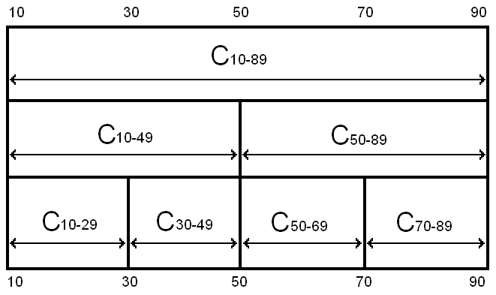
Robustness of Heuristics
= all legal results
= some illegal results
Notes:
Even though the problem is the same, and the hard constraints are the same, the heuristics can fail to stay within the hard constraints if they are asked to pack piece sizes they have not seen before
The safeguards against giving illegal solutions that work in one class will not work in another

Slide 38
The Best Fit Heuristic
Best fit = 1/(E-S). Point out features.
Pieces of size S, which fit well into the space remaining E, score well.
Best fit applied produces a set of points on the surface,
The bin corresponding to the maximum score is picked.
emptiness
Piece size

Slide 39
Our best heuristic.
Similar shape to best fit – but curls up in one corner.
Note that this is rotated, relative to previous slide.

Slide 40
Compared with Best Fit
Amount
evolved
heuristics
beat
best fit by.
Number of pieces
packed so far.
Averaged over 30 heuristics over 20 problem instances
Performance does not deteriorate
The larger the training problem size, the better the bins are packed.

Slide 41
Compared with Best Fit
Zoom in
of previous
slide
Amount
evolved
heuristics
beat
best fit by.
The heuristic seems to learn the number of pieces in the problem
Analogy with sprinters running a race – accelerate towards end of race.
The “break even point” is approximately half of the size of the training problem size
If there is a gap of size 30 and a piece of size 20, it would be better to wait for a better piece to come along later – about 10 items (similar effect at upper bound?).

Slide 42
A Brief History (Example Applications)
Image Recognition – Roberts Mark
Travelling Salesman Problem – Keller Robert
Boolean Satifiability – Fukunaga, Bader-El-Den
Data Mining – Gisele L. Pappa, Alex A. Freitas
Decision Tree - Gisele L. Pappa et. al.
Selection Heuristics – Woodward & Swan
Bin Packing 1,2,3 dimension (on and off line) Edmund Burke et. al. & Riccardo Poli et. al.

Slide 43
A Paradigm Shift?
One person
proposes one
algorithm
and tests it
in isolation.
One person proposes a
family of algorithms
and tests them
in the context of
a problem class.
Algorithms investigated/unit time
Human cost (INFLATION) machine cost MOORE’S LAW
conventional approach new approach
Previously one person proposes one algorithm
Now one person proposes a set of algorithms
Analogous to “industrial revolution” from hand to machine made. Automatic Design.
Notes:
What could you do after this talk you could not do before.

Slide 44
Conclusions
Algorithms are reusable, “solutions” aren’t (e.g. TSP).
We can automatically design algorithms that consistently outperform human designed algorithms (on various domains).
Heuristic are trained to fit a problem class, so are designed in context (like evolution). Let’s close the feedback loop! Problem instances live in classes.
We can design algorithms on small problem instances and scale them apply them to large problem instances (TSP, child multiplication).
Notes:
I hope if you are a researcher in the field it has made you think
If you do not know how to write an algorithm, don’t write it, let the computer write it. .

